Slide 1
ZEUS: Analyzing Safety of Smart Contracts
Yitao Jiang
CS 595 Software Security

Slide 2
Smart Contract
Introduction
Contribution
Technical details
Evaluation results
Limitations

Slide 3
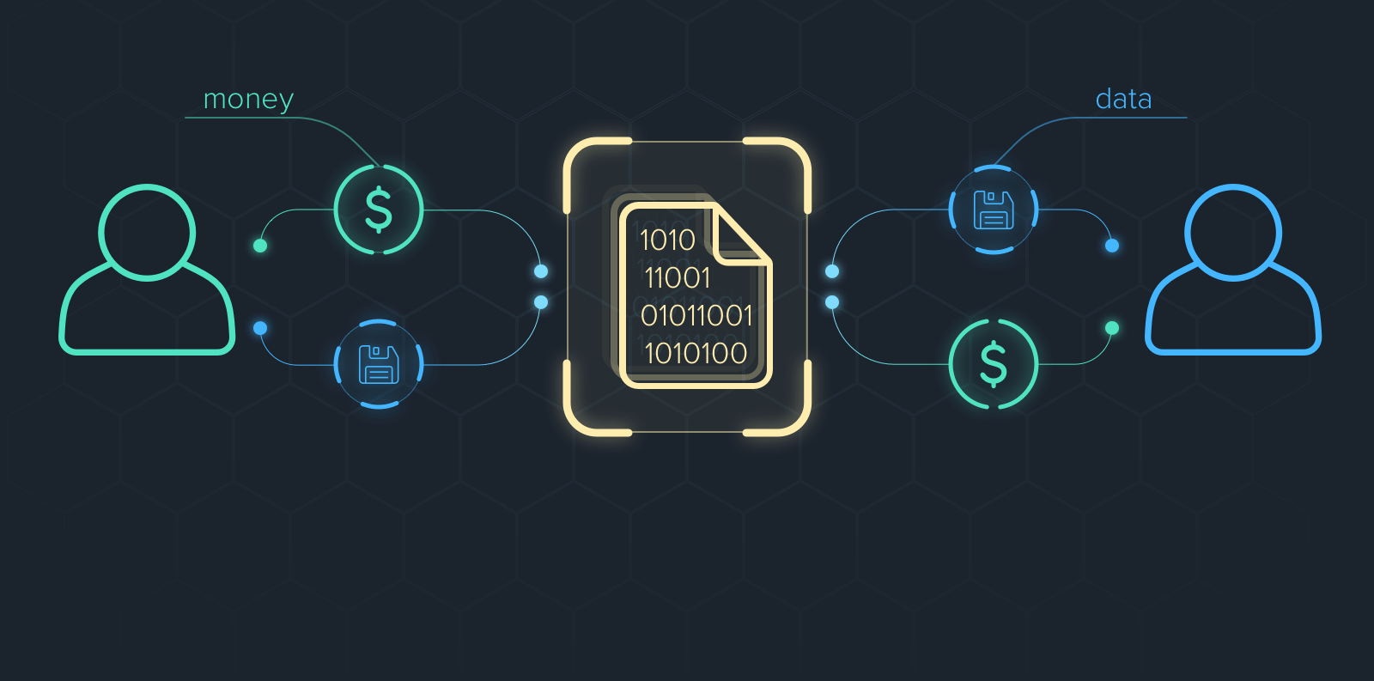
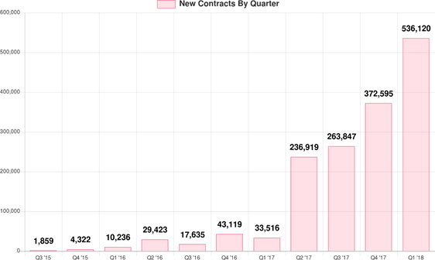
Introduction
smart contract is a self-executing contract with the terms of the agreement between buyer and seller based on blockchain.
what we need to verify:
correctness & fairness
Figure 1 # of New Smart-Contracts Created Each Q
Notes:
both correctness and fairness

Slide 4
Introduction
challanges:
manual auditing is impossible to an extent
one-shot program, immutable and hard to patch
Figure 1 # of New Smart-Contracts Created Each Q
Notes:
smart contract it is immutable and hard to patch
manual auditing is impractical

Slide 5
Prior work
Oyente: neither sound nor complete
because it is very hard to recreate the intent from the bytecode
several fairness and correctness issues are completely ignored
hard to handle loops
Bhargavan et al. propose a framework to formally verify smart contracts written in a subset of Solidity using F⭐
Why3
Notes:
very hard to recreate the intent from bytecode. Furthermore
Oyente ignores several newly discovered fairness and correctness issues, and is hard to handle loops.

Slide 6
Zeus
A high-level description
(1) take a smart contract and a policy as input
(2) perform static analysis atop the smart contract code to insert assert statements at correct program points. Translate the code into abstract language.
(3) translate the abstract language embedded with policy assertions to LLVM bitcode.
(4) invoke its verifier to determine assertion violations
Notes:
Motivated by this, the authors present the design and implementation of ZEUS. A smart contract verification framework using abstract interpretation and symbolic model checking. Here's a high-level description of Zeus. First it takes a smart contract and a policy as input. Notice that the policy is generated by policy builder with user assistance, which is a correctness and fairness criteria. Then it performs static analysis atop the smart contract code, inserts assert statements at correct program points, translate the code into abstract language. Then it translates the abstract language embedded with assertions to LLVM bitcode. Finally it invokes its verifier to determine assertion violations.

Slide 7
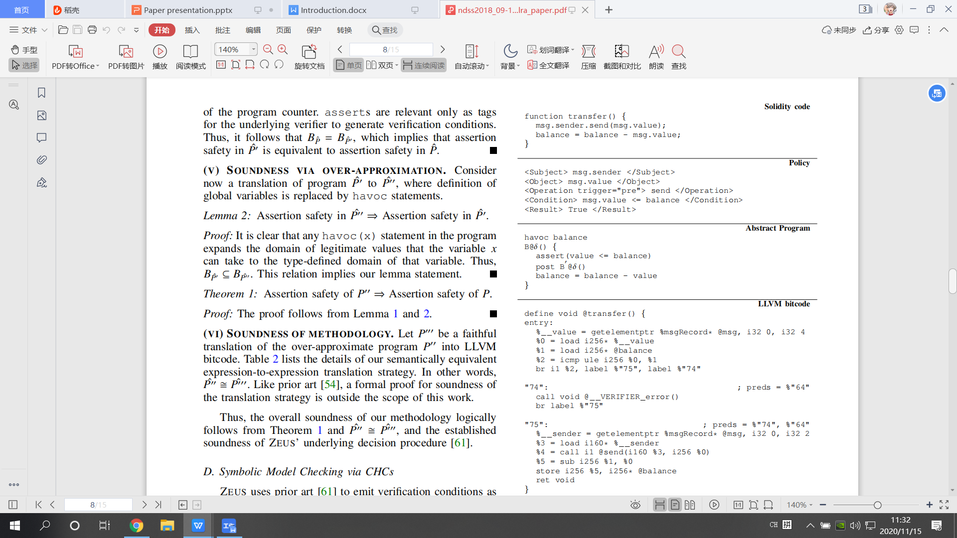
Zeus
Notes:
Here's an end-to end example complete with all program transformations, just give you a rough picture of what Zeus does. I will show it again to explain it in details later.

Slide 8
Contributions
classify several new and previously known issues but unstudied in the context of smart contracts.
ZEUS, a symbolic model checking framework for verification of correctness and fairness policies
build the first Solidity to LLVM bitcode translator
present the first large scale source code analysis of Solidity-based smart contracts
Notes:
For contributions, the authors classify several new and previously known but unstudied issues in the context of smart contracts and show that they can potentially lead to loss of money.
They also present ZEUS framework. Within Zeus, they build the first Solidity to LLVM bitcode translator so that they can do verification atop LLVM bitcode. In the evaluation part, They present the first large scale source code analysis of Solidity-based smart contracts with more than twenty thousand samples, indicating that about 94% of them are vulnerable to one or more correctness issues.

Slide 9
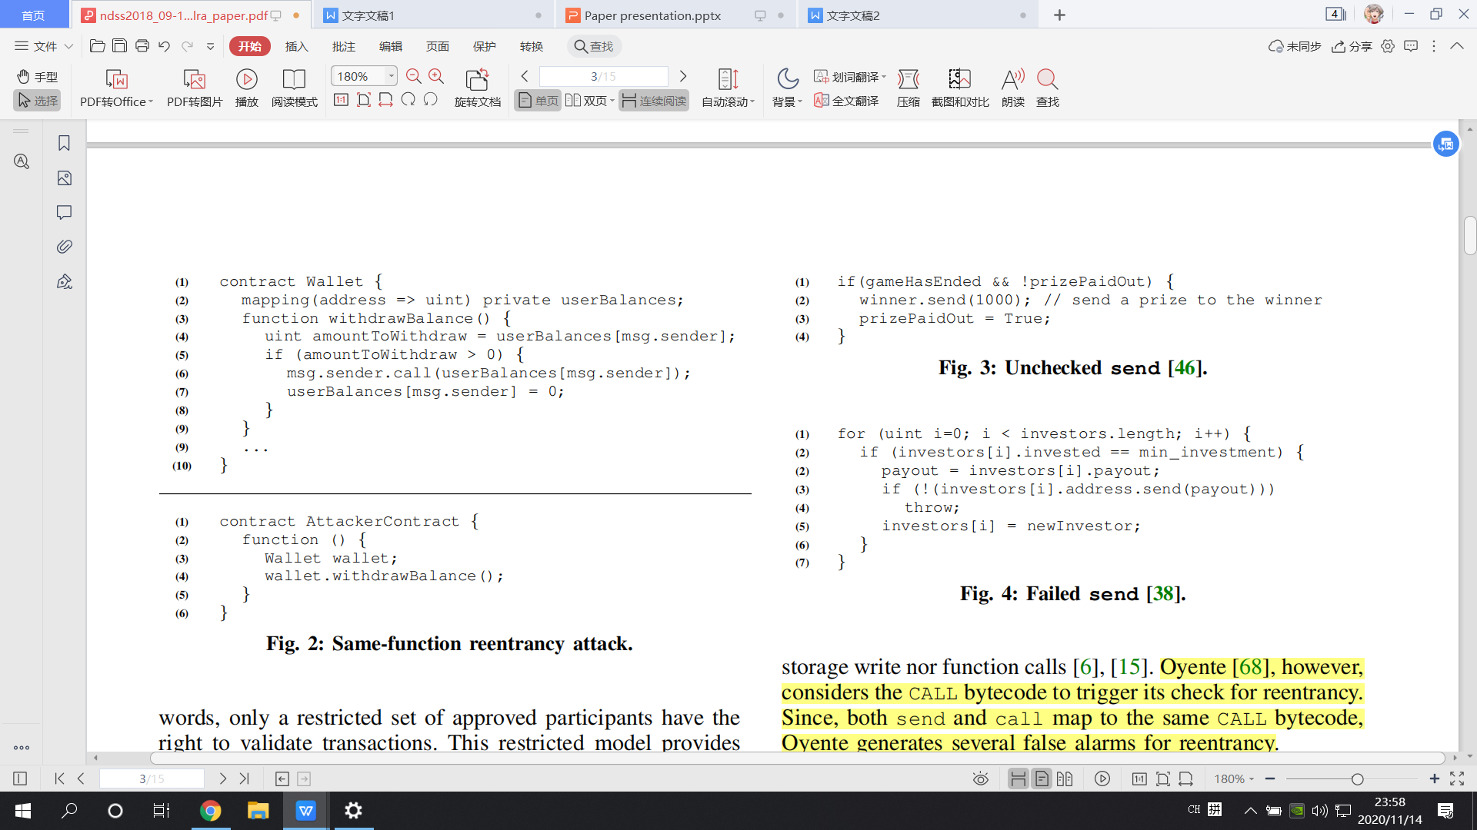
Correctness issues
reentrancy
invoke the fallback function, reinvoke withdrawBalance(), then invoke fallback function again and again
Notes:
Zeus considers many issues that not been discussed in Oyente. For correctness issues, first one, reentrancy. We are already familiar with it. So I'll just skip.

Slide 10
Correctness issues
Unchecked send
exception is not handled properly
allow modifications to the global state after that
prizePaidOut is still set to be “True” even if send fails
Notes:
Unchecked send. First we need to know that malicious attacker is able to intentionally make send fail. If contracts do not correctly handle such failed invocations, and allow modifications to the global state after that, it may cause problem. Let's look at this example. The prize will be sent to the winner. Then the global variable prizePaidOut is set to be true to represent that the prize is already sent. However, if the send call fails, prizePaidOut will still be set to true. What will happen to the winner is that he can never receive his prize.

Slide 11
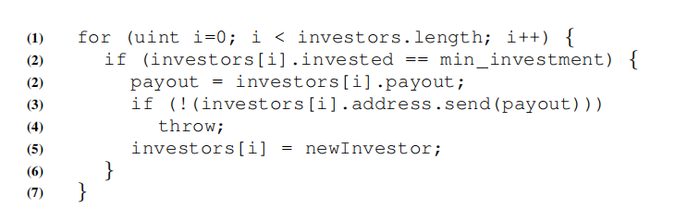
Correctness issues
Failed SEND.
If the capacity of investors is full, a new investor offers more money than the current smallest investor can take his place.
The adversary is the smallest investor, using computation-heavy fallback function to intentionally cause SEND failing.
Then no new investor can join.
Notes:
To deal with failed send, utilizing throw to revert transaction is a good idea. However, it is not enough. Let's see this example. The contract has a certrain number of investors. When the number of investors reaches maximum, and a new investor shows up. If he offers more money than the current smallest one, the contract will let the new one take his place. Imagine the adversary invest merely enough to be the smallest investor. After the investor is full, it can lock this function by making send failing forever.Then no new investor can join, which can cause a great loss to the contract owner.

Slide 12
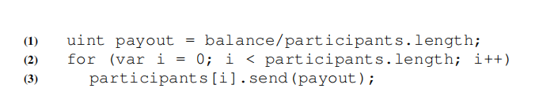
Correctness issues
Integer overflow/underflow
Type of i is uint8
The payout is only sent to the first 255 participants
Notes:
Integer overflow problem. This is easy to understand. In this example, the value i can store 255 participants at most. Even if participants number grows larger than 255, the payout will be only sent to the first 255 ones.

Slide 13
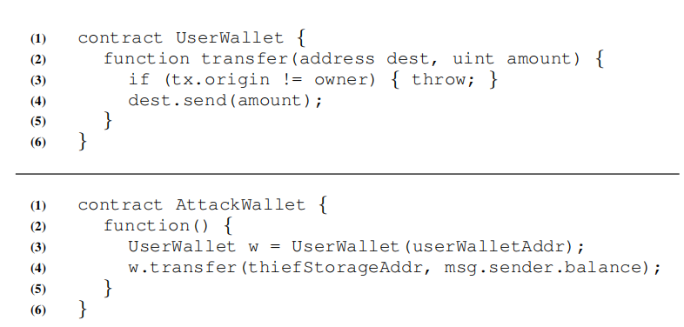
Correctness issues
Transaction state dependence
Requires the user to invoke the AttackWallet
Since the originator of the call chain is the owner, the check
“if (tx.origin != owner)” fails.
It should be replaced by “if (msg.sender != owner)”
contract owner
(originer of call chain)
AttackWallet
UserWallet.transfer
tx.origin = owner(yes)
send money to the address given by attacker
Notes:
Transaction state dependence problem. Contract writers can utilize transaction state variables.like tx.origin is used to find the originer of a call chain. The code in line3 uses this state to checks whether the function is called by the owner of contract. However, tx.origin equals to the origin of call chain but may not equal to the caller of function. Imagine the attacker utilize some social engineering techniques to cheat the owner to invoke AttackWallet. Since the originer of call chain is the owner himself, the check will pass and money will be sent to the address given by the attacker.

Slide 14
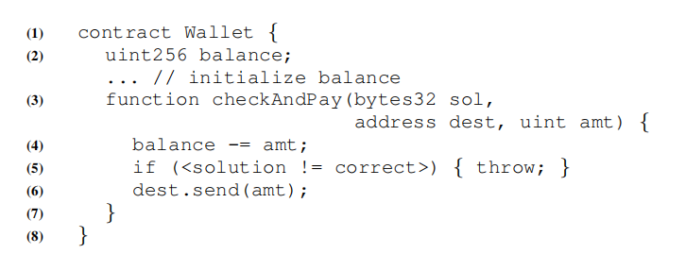
Fairness issues
Absence of logic
Access to sensitive resources and APIs is not guarded.
if send fails, the owner can get the solution of the puzzle without paying anything
Notes:
Absence of logic problem. If access to sensitive resources and APIs is not guarded, some problems may happen. For example, in this example, the owner pays to solver to get solution of puzzle. But if send fails, he can get solution without paying anything, which is unfair to the solver.

Slide 15
Fairness issues
Incorrect logic
for example:
+= coded as =+
>= coded as <=
Notes:
Also incorrect logic is a problem. Such as coding errors.

Slide 16
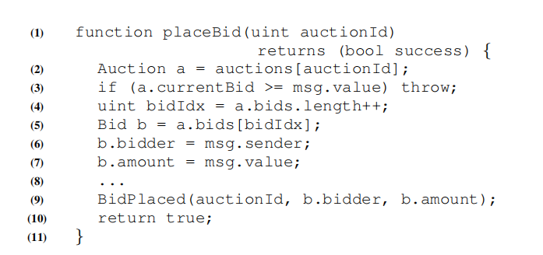
Fairness issues
Logically correct but unfair
This contract does not follow fair auction rules.
Sellers can participate in bidding, even withdrawing the item
before being sold, which is unfair to bidder.
Notes:
Some contract defines well, but violates fair marketing rules. For example, this contract is designed for auction. But whether the auction is “with reserve”is not disclosed to the bidder. Which means sellers can also participate in bidding, even withdrawing the item before being sold, which is unfair to bidder.

Slide 17
Miner influence
Block state dependence
The miner can determine block state variables which can be used to generate randomness. He can insert suitable values to favor payouts intended for him.
Transaction order dependence
The miner can influence the outcome of a transaction by reordering.
Notes:
Finally, some miner influence should also be considered. The miner is able to determine the block state variable and transaction order. If the outcome of a transaction is related to them, the miner can utilize this privileges to get favor payouts for him.

Slide 18
Zeus structure
policy builder
Solidity to LLVM Bitcode Translator
verifier

Slide 19
Policy builder
Policy:
a XACML styled five tuple,consisting of <Sub, Obj, Op,Cond, Res>
Sub (subject)
Obj (object)
Op (operation)
Cond (condition)
Res (result)
Notes:
The policy is generated based on source code with user's assistance. In other word, user can decide what kind of policy to insert in order to ensure fairness. Each policy is composed of five tuples: subject, object, operation, condition and result. They are generated according to user's choice. It seems very complicated. In short, policy is a specified language to show user's requirements.I will use an example to explain the policy.

Slide 20
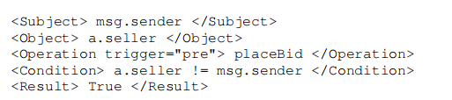
Policy builder
The user chooses to track the message sender
Only when the seller is not the caller, placeBid is allowed to be called.
So fairness is guaranteed.
Solidity source code
Policy
Notes:
It is based on the auction contract I showed in the previous slide. The user selects message sender as the subject, seller as object, and function placeBid as operation. The condition is that only when the seller does not equal to message sender can the function be called. Result is set to be true. The meaning of this policy is: only if the caller of function placeBid is not the seller can this function be called. So this policy ensures fairness for bidder.

Slide 21
Policy builder
Steps to build policy
run a taint analysis pass over the contract code.
Sub: list the set of all available taint sources. Users selects subjects from it.
Obj: filter the results from the taint pass according to selected subjects. User selects object from them.
Op: display the list of potential invocations that involve selected subject and object. User selects.
Cond: lists the available predicates encountered. The user can compose these predicates (or specify his own) using boolean operators to form the condition.
Res: indicated by user
Notes:
In short, Zeus runs a taint analysis over the contract code and extract available subjects for user to select. According to the user selection, Zeus filter further to list available objects. Subject, object and opration can all be decided by such a user-interaction mode. Condition and Result, which is different, can be specified by the user.

Slide 22
Policy builder
A brief introduction of abstract language
havoc: assign a non-deterministic value to variable
assert: a check of truth value
send, transfer, and call family → the post statement
Notes:
The authors also define an abstract language to capture the main structure of Solidity. The details are not important. We just need to know that it can map concrete values and operations into abstract ones. Just like the example shows.

Slide 23
Policy builder
Translation of policy to assertions
ZEUS leverages the policy tuple to extract:
(a) predicate (i.e., Cond) to be asserted(what to insert)
(b) the correct control location for inserting(where to insert)
Notes:
After this policy is generated, we need to translate it into assertions to check whether the policy is violated during execution.
Two problems we need to solve are: what to insert and where to insert.
What to insert? The answer is condition tuple. Let's see the example. The predicate of assertion is equal to Condition.
Where to insert? It can be determined by a combination of Subject, Object and Operation.
As the example shows, the combination of these three can locate this unique send call which involves both msg.sender and msg.value. The “trigger = pre”here means that the assertion should be inserted before the send. If “trigger = post”, it will just be the opposite.

Slide 24
Solidity to LLVM Bitcode Translator
Ensuring soundness
(1) Execution order: reason about O(n²) possible orderings for a contract. (n is the number of functions in the contract)
(2) Path traversal: For any concretely defined starting values, ZEUS automatically havocs them to explore the entire data domain
Modeling Solidity syntax
(1) Inheritance
(2) External functions
(3) Arrays
(4) Rational Ether
Handling LLVM optimizations
Notes:
Next the translator is invoked and the code will be translated into LLVM Bitcode. After translation, Zeus will utlize existing symbolic model checking backend for verification over LLVM bitcode. Like Seahorn. Using existing tested tools on LLVM code benefits a lot. While translating is not easy. First, soundness should be ensured. Since we are not sure of the execution order and how values can be, it is necessary to enumerate all possiblities. It is shown in the paper that for execution order, building n square orderings of functions for one contract is enough. For path traversal, Zeus transforms concrete values into non-deterministic ones to explore all possible control paths. There're some more issues,which are just implementation details so I'll skip the explaination.

Slide 25
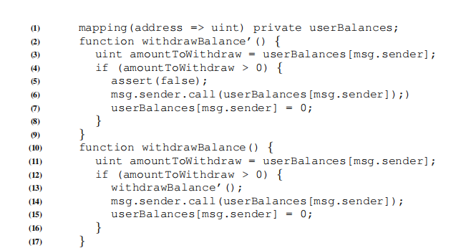
Handling Correctness Bugs
Reentrancy
cloning the function under consideration,
and inserting a call to the clone before the invocation to call
Notes:
Fairness issues can be solved by inserting policies with user assistance. What about correctness bugs. The answer is similar. They can also be detected via inserting policy assertions. but automatically. Let's see how it works.
First one, reentrancy. The reentrancy can happen via call method. So Zeus first clones the possible reentrant function,then insert a call to the clone before the invocation to call. After going into the clone function, if assert is triggered, it means that it is possible to reinvoke the function again safely. This is a reentrancy bug.

Slide 26
Handling Correctness Bugs
Unchecked send
ZEUS initializes a global variable checkSend to true and takes its conjunction with return value from every send operation.
insert assert(checkSend) before every subsequent write of a global variable
Failed send
same as unchecked send expect inserting assert before “throw”
However, the throw encountered may due to some other condition in the code instead of send
Notes:
For unchecked send, it is simple. Zeus will initialize a global variable checkSend to true. For every send operation, and take its conjunction with return value from every send operation. Each time a global variable is written, it will check whether checkSend is true. Imagine if send fails without reversion, the value of checkSend will become false. If global variable is written after that, the assertion will be triggered.
For failed send, it is similar to unchecked send, the only difference is to insert assertion before throw. However, sometimes throw may due to other conditions and is not related to the failed send.

Slide 27
Handling Correctness Bugs
Integer overflow/underflow
An LLVM pass implements the overflow/underflow detection checks for all arithmetic
Transaction order dependence
taint all global variables that are written to and then
determine if this taint flows into a send or call.
Notes:
For Integer overflow/underflow An LLVM pass implements the overflow/underflow detection checks for all arithmetic. For transaction order dependence
taint all global variables that are written to and then determine if this taint flows into a send or call.

Slide 28
Handling Correctness Bugs
Block/ Transaction state dependence
implement taint analysis pass over LLVM bitcode and use symbolic model checking to eliminate infeasible paths.
determine if block/transaction state variables, such as timestamp, flow into send or call.
Notes:
For Block/ Transaction state dependence, Zeus implement taint analysis pass over LLVM bitcode and use symbolic model checking to eliminate infeasible paths. It then determine if block/transaction state variables, such as timestamp, flow into send or call.

Slide 29
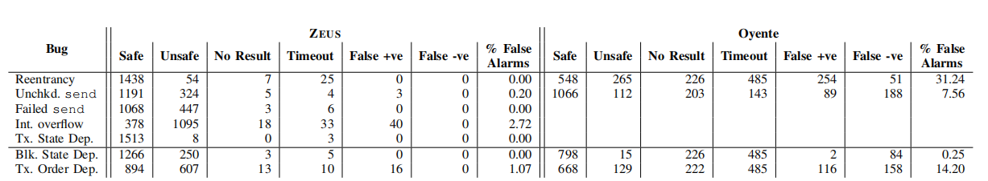
Evaluation
21, 281 out of 22, 493 contracts are vulnerable
ZEUS’s use of abstract interpretation along with symbolic model checking for verification makes it sound (0 false negative, low false alarm)
Use of CHCs enable quick verification
Easy to extend ZEUS to other blockchain platforms and
verifiers
Notes:
The authors obtain more than twenty thousand source code for evaluation. The results are compared horizontally with Oyente. For summary, first, 94 percent of detected contracts are vulunable. Next, Zeus is sound, with zero false negative and low false alarm. Also, the usage of CHC on LLVM code enables quick verification, much faster than Oyente. Also they demonstrate ZEUS’s versatility with other blockchain platforms and verification engines. The results shows that Zeus has a good scalability

Slide 30
Limitations
Fairness properties involving mathematical formulate are
harder to check.
constructs like throw and selfdestruct which have no exact LLVM bitcode transformation are modeled as a program exit.
EVM parameters like gas consumption cannot be precisely computed
ZEUS does not support virtual functions
ZEUS is conservative and does not analyze contracts with an assembly block
Verification of liveness (i.e., something good must eventually happen) requires support for linear temporal logic, and is currently not supported by ZEUS
Notes:
There are also many limitations of Zeus.
Fairness properties involving mathematical formulate are
harder to check.
constructs like throw and selfdestruct which have no exact LLVM bitcode transformation are modeled as a program exit.
EVM parameters like gas consumption cannot be precisely computed
ZEUS does not support virtual functions
ZEUS is conservative and does not analyze contracts with an assembly block
Verification of liveness (i.e., something good must eventually happen) requires support for linear temporal logic, and is currently not supported by ZEUS
Besides, from my point of view, there is one limitation of fairness. For some contract designed for games or gambles, it is rather difficult for inexperienced users, to tell whether a contract works as advertised, even with the source code available. So it is difficult to generate applicable policy. I think maybe it is possible to extract the mechanism from soure code, so that it will be easier to generate policies according to it.

Slide 31
Thank you
Yitao Jiang
CS 595 Software Security

